Slide 1
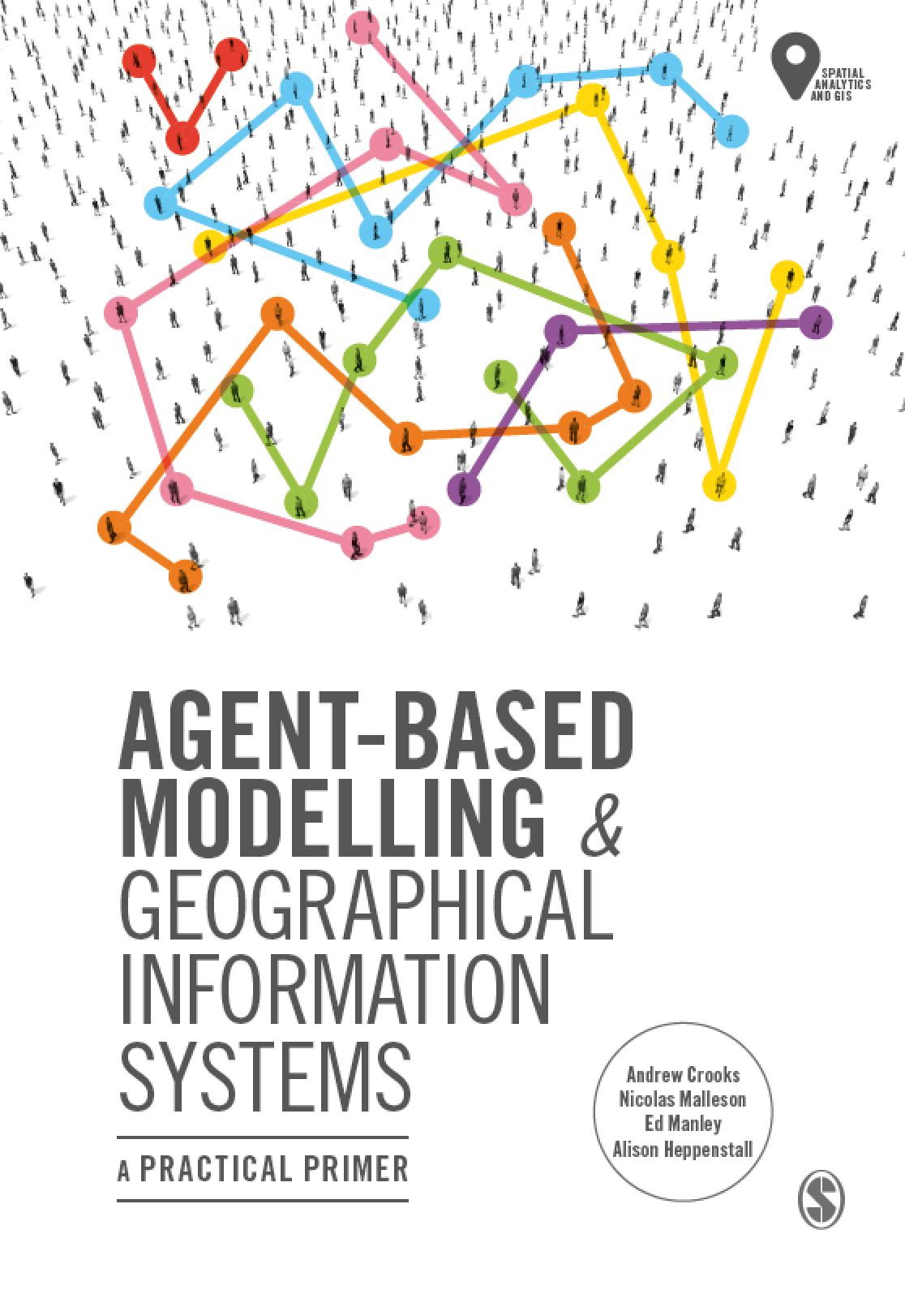
Chapter 8
Networks
Notes:
Networks play a critical role in our lives in terms of physical networks we use to navigate upon, our social networks and more recently how we communicate via cyber networks (e.g. social media). This chapter provides a brief introduction to such networks and shows how they can be integrated into agent-based models. Importantly, a model is also introduced that demonstrates how to navigate agents along a physical road network (this is a common requirement for spatially-explicit agent-based models). The chapter concludes with a discussion about how networks can be combined to study real world phenomena and highlight future areas of research.

Slide 2
Learning Objectives

Slide 3
Introduction

Slide 4
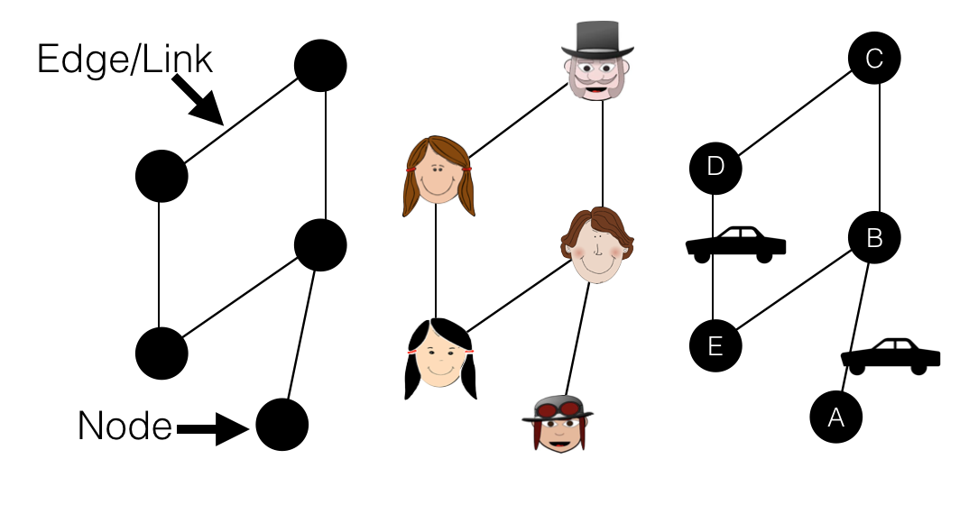
Graphs and Networks
Figure 8.1: From left to right, a basic graph, a social network and a simplified transportation network.

Slide 5
Basic Network Properties

Slide 6
Defining Graphs Mathematically

Slide 7
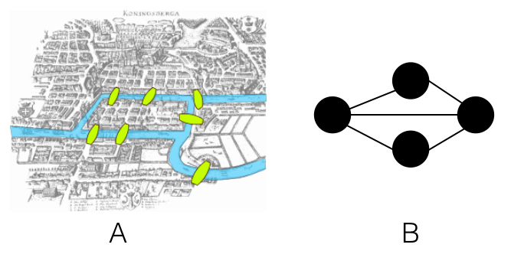
The Seven Bridges of Konigsberg problem
Figure 8.2: The Seven Bridges of Konigsberg problem. A: the physical depiction of the bridges (Source: Giusca, 2017) and B: the graph representation

Slide 8
Building Graphs in NetLogo

Slide 9
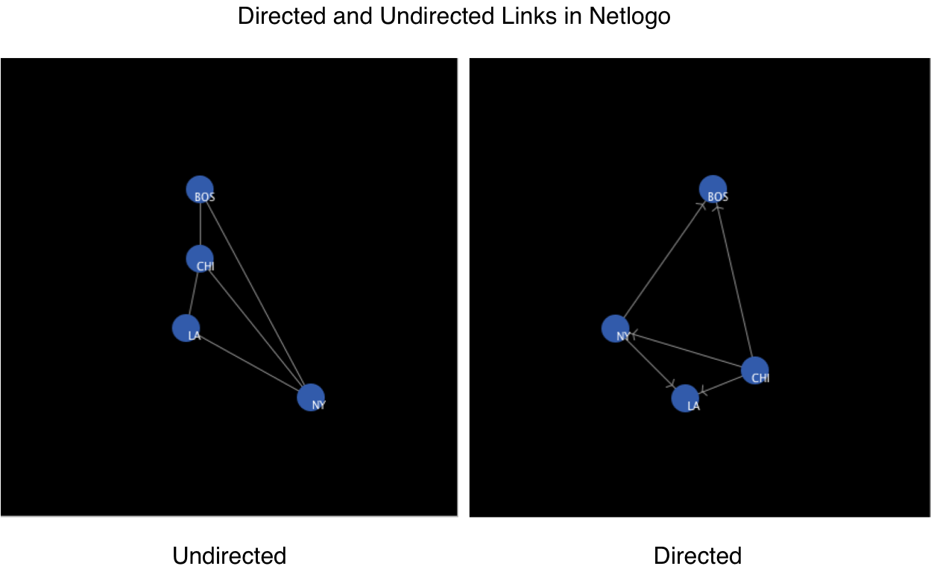
Directed and Undirected Links in NetLogo
Figure 8.3: Directed and undirected links as displayed in NetLogo. These examples are from the ‘Undirected Network Demo’ and ‘Directed Network Demo’ at: https://github.com/abmgis/abmgis/tree/master/Chapter08-Networks/Models.

Slide 10
Adjacency Matrices and Node Degree

Slide 11
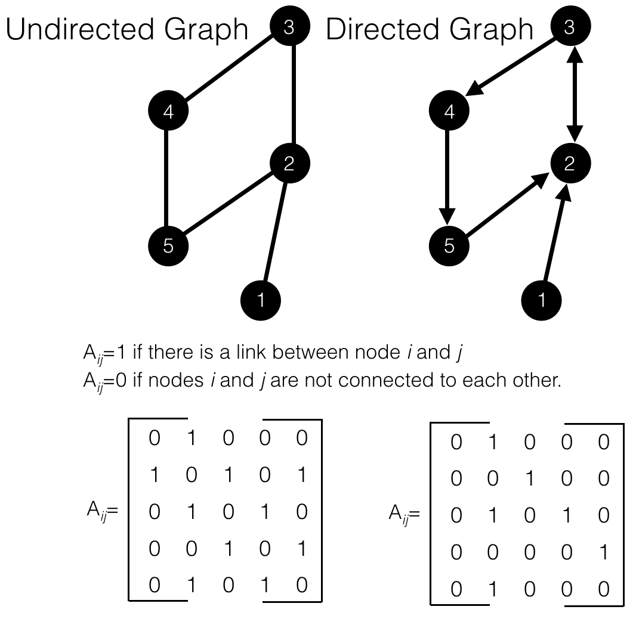
Adjacency Matrix for a undirected and directed graph.
Figure 8.4: Adjacency Matrix for a undirected and directed graph.

Slide 12
Traversing Graphs

Slide 13
Graph Density

Slide 14
Calculating Node Importance

Slide 15
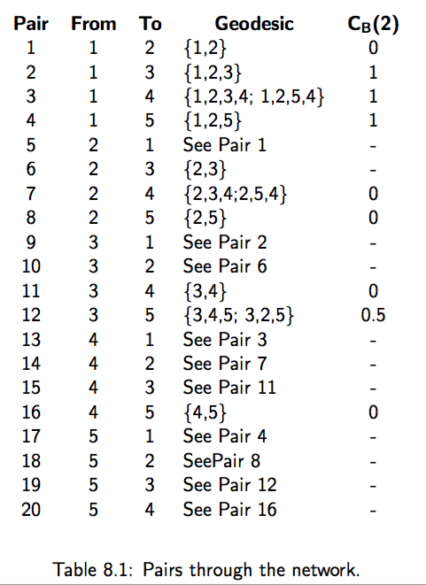

Slide 16
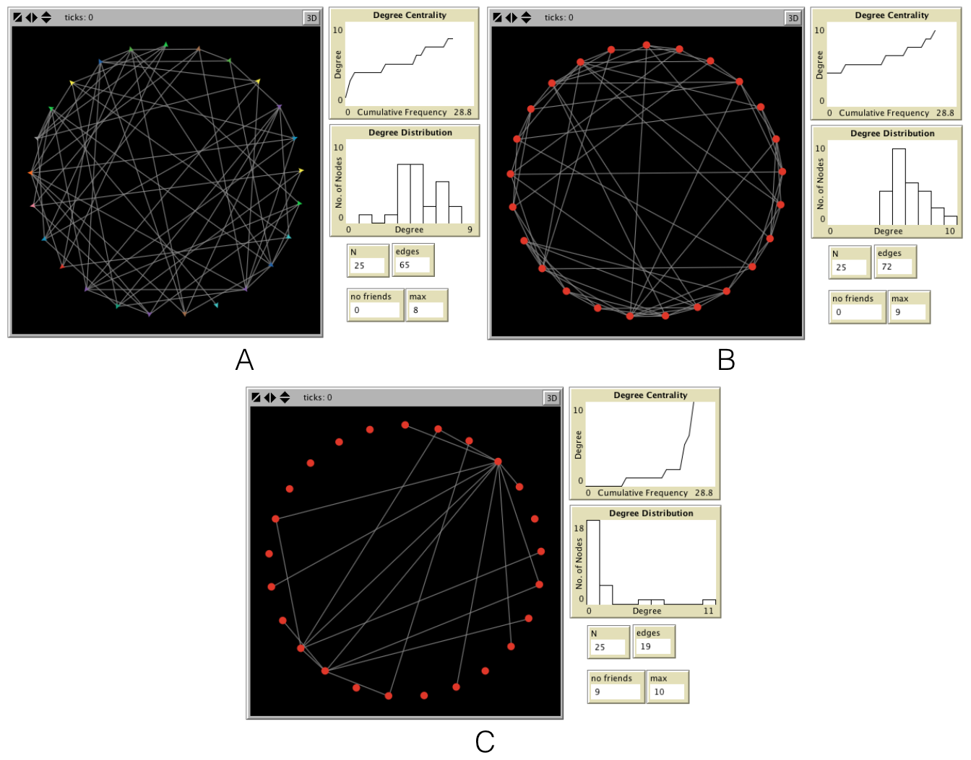
Network Structures
Figure 8.5: Different network structures based in 25 nodes, 0.2 probability of a link; A: Random B: Small-World C: Scale-Free.

Slide 17
Random Networks

Slide 18
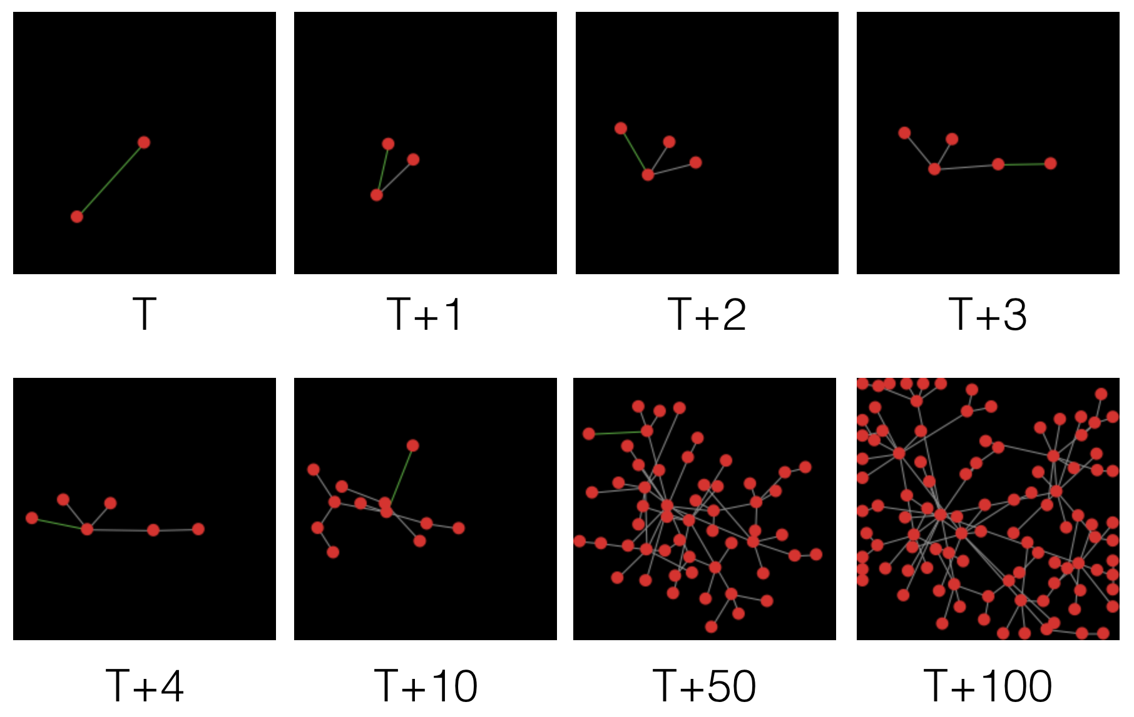
Scale Free Networks
Figure 8.6: Growth of a scale-free network via preferential attachment. (Source: Wilensky, 2005b)

Slide 19
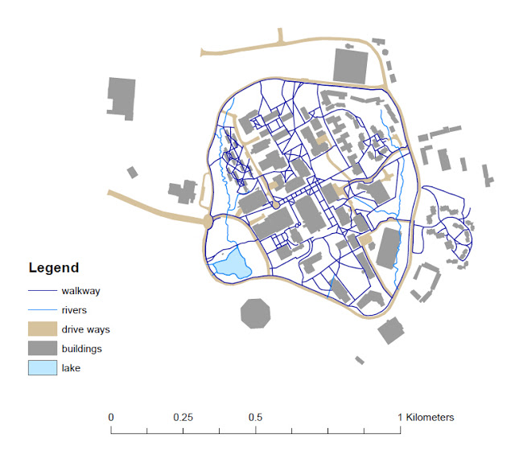
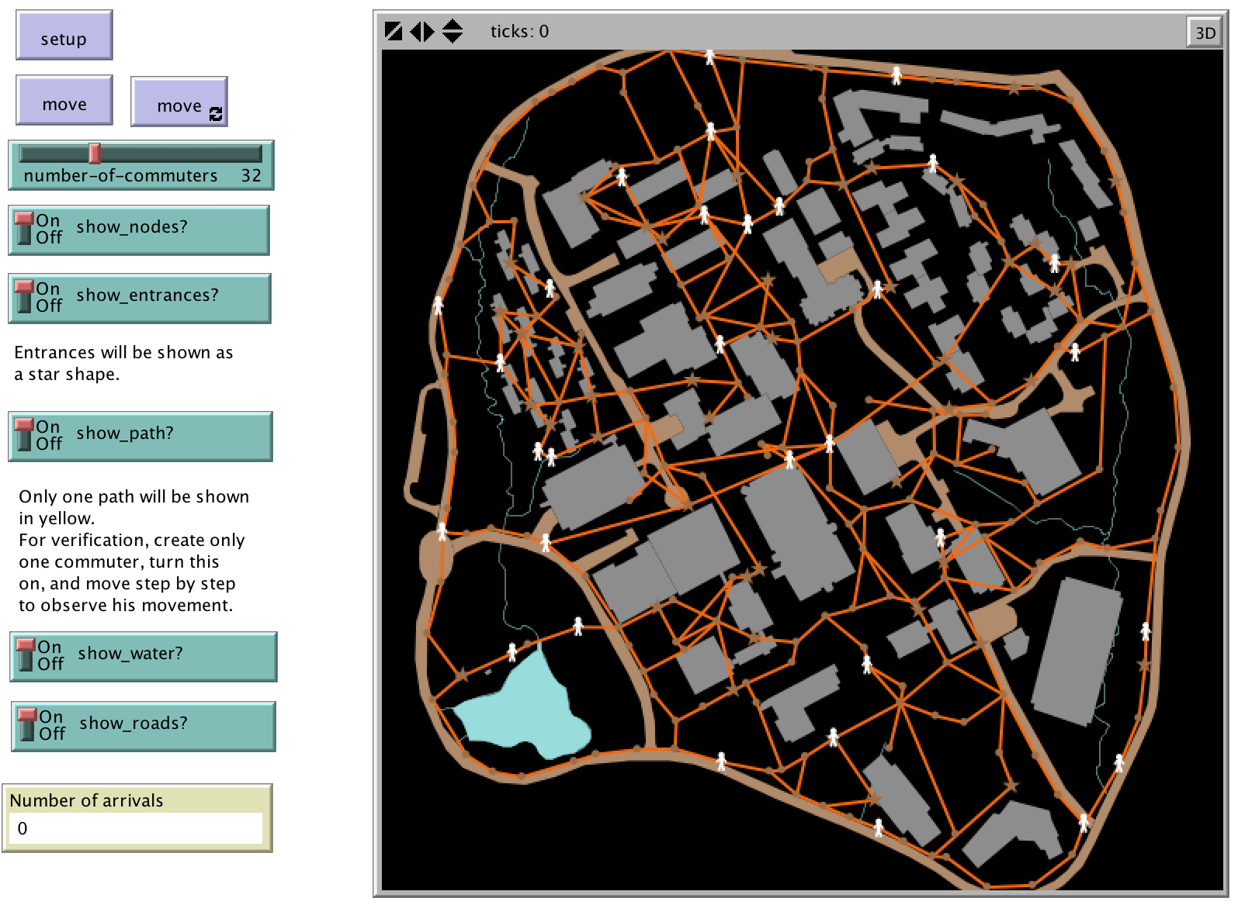
Transport Networks
Figure 8.7: Network representation within a GIS, specifically two types of networks, that of walkways and rivers.
Figure 8.8: A road network imported into NetLogo, from the GMU-Roads model.

Slide 20
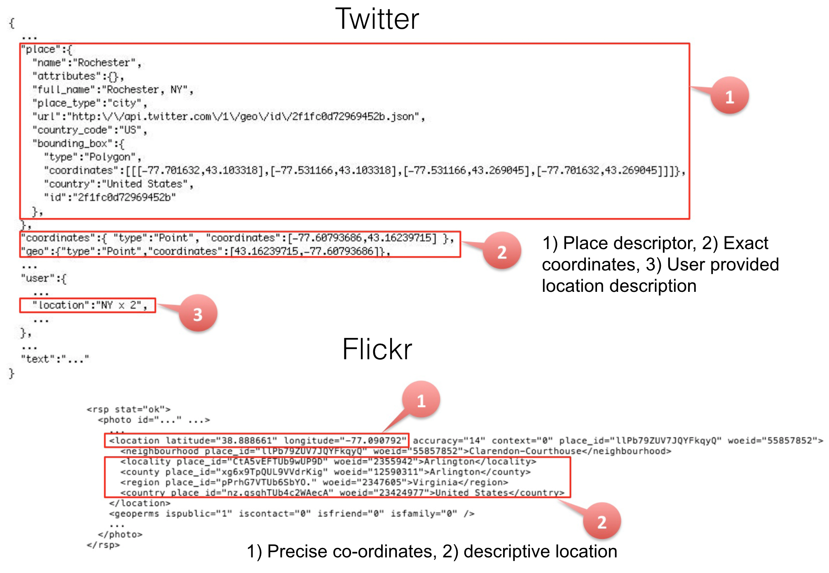
Linking Geographical and Social Networks
Figure 8.9: Metadata from Twitter tweets (top) and Flickr photos (bottom)

Slide 21
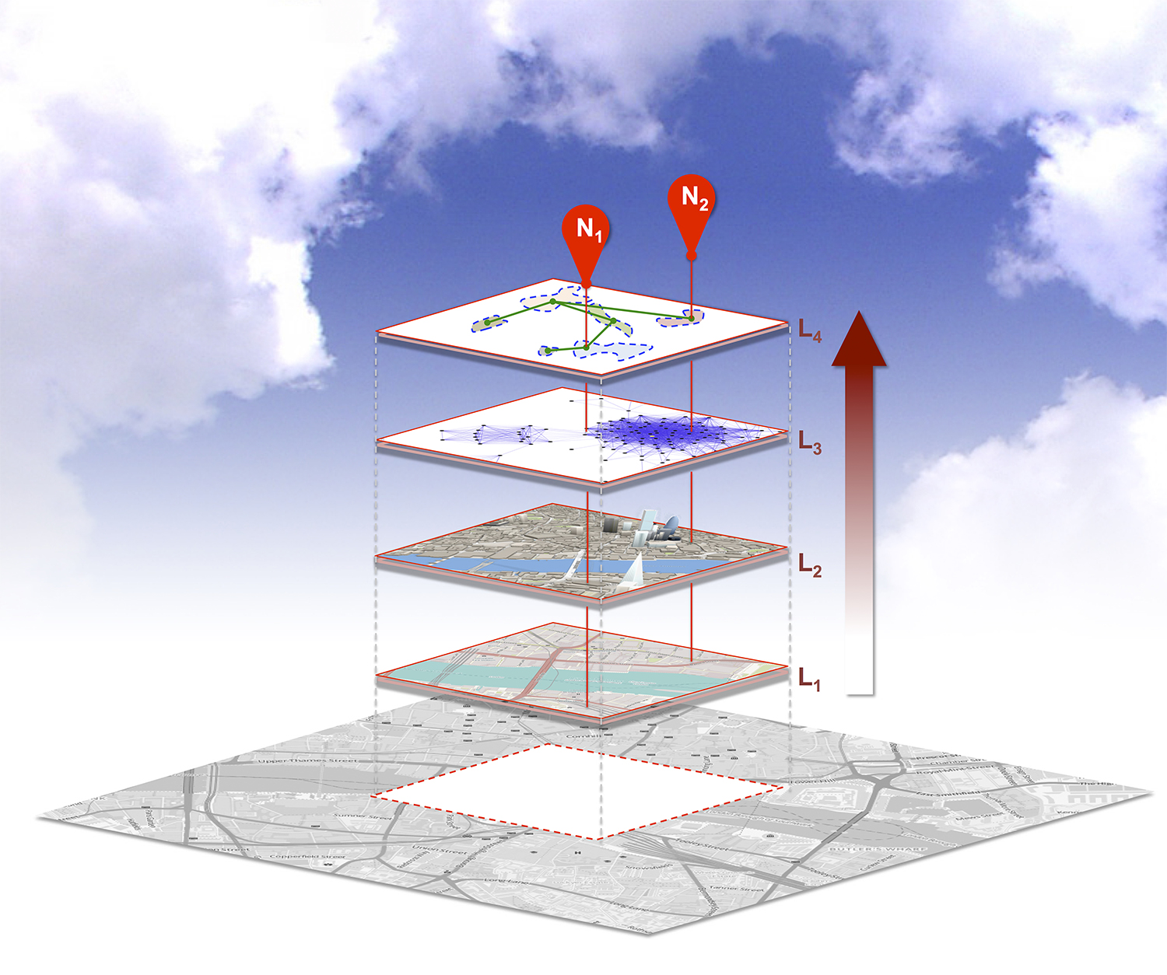
Figure 8.10: Schematic diagram illustrating how different networks can be linked together. From physical (L1, L2), and social (L3) spaces to derive place abstractions (L4) for different locations (N1, N2). (Source: Crooks et al., 2016)

Slide 22
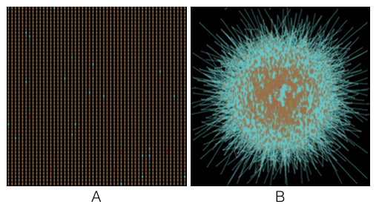
Figure 8.11: Agents and Networks: A: The Physical environment and B: the agents social (cyber) networks.

Slide 23
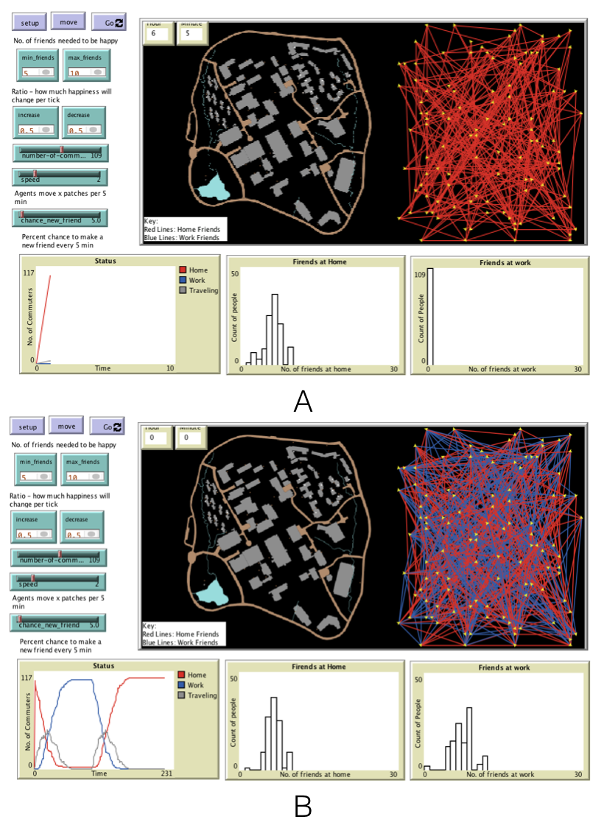
Agents and Networks
Figure 8.12: Agents and Networks related to going to and from work A: Initial social network based home locations while B: shows how the social network evolves over time as agents interact with each other.

Slide 24
Notes:
In this chapter we have demonstrated how the complex realities of the world around us can be abstracted into a graph and how such a graph can be analysed to shed light onto the the importance of a node whether this be in terms of a person or a intersection in a road. We also discussed various types of networks from random to that of scale free and demonstrated the key properties of each before discussion how both physical and social networks can be combined using a common method of abstraction, i.e. a graph. The symbiosis of network analysis and agent-based modelling is to be able to capture how network structures can influence how individual agents behave (based on how they are connected to other agents) or move through geographical systems. At the same time new forms of data (e.g.. social media, mobile phone calls) is shedding light on peoples connections and provide new opportunities to study geographical systems.

